Slide 1
Dear participants,
We would like provide here a LinkedIn or Facebook posting.
Just select one template, insert your photo + logo and your name + the name of your organisation.
Save it as picture and let your LinkedIn or Facebook community know, that they can meet you on this event.

Slide 2
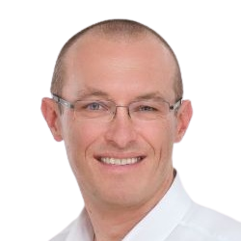
Meet with @ https://he-industry-2023-brokerage.b2match.io/
Thomas Röblreiter
Austrian Research Promotion Agency

Slide 3
Meet with @ https://he-industry-2023-brokerage.b2match.io/
Thomas Röblreiter
Austrian Research Promotion Agency

Slide 4
Meet with @ https://he-industry-2023-brokerage.b2match.io/
Thomas Röblreiter
Austrian Research Promotion Agency

