Slide 1
OPPORTUNITIES FOR COOPERATION BETWEEN BRAZIL AND THE EU
Social Sciences and Humanities

Slide 2

ABOUT FGV
Fundação Getulio Vargas (FGV) was considered to be one of the six most important think tanks in the world. Besides this general classification among the top think tanks, FGV was also ranked as the best institution in this category in South and Central America and the tenth leading institution in the world with focus on production of applied research with impact on the implementation of public policies. Finally, in the specific area of social policies, FGV occupies fifth place in the world.

Slide 3
FGV’S SCHOOLS AND CENTERS
The schools and research centers at FGV have complete academic and operational independence. Each year, these units, with their 716 researchers, are responsible for producing hundreds of articles and other academic texts which serve as a base for public debates among researchers and representatives of the public and private sectors.
In the past two years:
The researchers have participated in more than 250 congresses, seminars and other events abroad to present articles and posters.
FGV has sponsored more than 400 congresses, seminars and other events, with strong participation of foreign researchers.

Slide 4

RESEARCH & INNOVATION BILATERAL AGREEMENTS BETWEEN THE EU AND BRAZIL
Science and Technology Cooperation Agreement between the European Community and Brazil
Signed in 2004 Active since August 2007 Renewed until 2022
Last meeting: Brussels (November 29th 2017) The last meeting EU-Brazil Joint Steering Committee Meeting on Science and Technology Cooperation took place in Brasilia on 30th April
Cooperation Agreement between the European Community of Atomic Energy (EURATOM) and Brazil in the area of Fusion Energy Research
Signed in 2009 Active since January 2013 renewed until 2023
Last meeting: Culham/United Kingdom (September 2015)
MCTIC-JRC CE Cooperation Arrangement aimed at scientific activities areas of common interest
Signed and active since January 2013 Renewed until 2023
Last videoconference in May 2018
Areas of common interest:
Disaster prevention and crisis management; climate change and sustainable management of natural resources and ecosystem services; energy (including bioenergy and smart grids); food security, bio-economy; ICT; nanotechnologies.

Slide 5
RESEARCH & INNOVATION BILATERAL AGREEMENTS BETWEEN THE EU AND BRAZIL
Implementing Arrangement on ERC, signed between European Comission and CONFAP
Signed in 2016
Last meeting: Rio de Janeiro (August 01st 2019)
It aims to support the integration of brazilian researchers in active ERC projects
Arranjo Administrativo Horizonte 2020, signed between European Comission DG-RTD, CNPq, FINEP and CONFAP
It aims to be na extension of co-financing mechanisms to finance Brazilian participations in Horizon 2020, encouranging parallel activities and coordinated actions, as well as increasing mutual knowledge about programs and opportunities.
Signed in 2018

Slide 6
EUROPEAN UNION CALLS WITH PRIORITY TO INTERNATIONAL COOPERATION
Socioeconomic and cultural transformations in the context of the fourth industrial revolution
Transformative impact of disruptive technologies in public services Deadline: 03/12/2020 (DT-TRANSFORMATIONS-02-2018-2019-2020 )
Curation of digital assets and advanced digitisation
Deadline: 03/12/2020 (DT-TRANSFORMATIONS-12-2018-2020)
Culture beyond borders – Facilitating innovation and research cooperation between European Museums and heritage sites.
Deadline: 03/12/2020 (TRANSFORMATIONS-19-2020 )
Enhancing access and uptake of education to reverse inequalities
Deadline: 03/12/2020 (TRANSFORMATIONS-22-2020)

Slide 7
EUROPEAN UNION CALLS WITH PRIORITY TO INTERNATIONAL COOPERATION
Governance for the future
Addressing radicalization through social inclusion Deadline: 03/12/2020 (SU-GOVERNANCE-09-2020)
New forms of delivering public goods and inclusive public services Deadline: 03/13/2020 (DT-GOVERNANCE-05-2018-2019-2020)
Developing deliberative and participatory democracies through experimentation
Deadline: 03/12/2020 (SU-GOVERNANCE-21-2020)
Citizen-centric public services in local and regional administrations
Deadline: 03/12/2020 (DT-GOVERNANCE-22-2020)

Slide 8
EUROPEAN UNION CALLS WITH PRIORITY TO INTERNATIONAL COOPERATION
Environment
Innovative nature-based solutions for carbon neutral cities and improved air quality Deadline: 02/13/2020 (LC-CLA-11-2020)
Understanding the transition to a circular economy and its implications on the environment, economy and society Deadline: 02/13/2020 (CE-SC5-25-2020)
Develop and pilot circular systems in plastics, textiles and furniture sectors Deadline: 02/13/2020 (CE-SC5-28-2020)
Plastics in the environment: understanding the sources, transport, distribution and impacts of plastics pollution Deadline: 02/13/2020 (CE-SC5-30-2020)

Slide 9
EUROPEAN UNION CALLS WITH PRIORITY TO INTERNATIONAL COOPERATION
Transport
Network and traffic management for future mobility Deadline: 01/09/2020 (MG-2-11-2020)
Improving road safety by effectively monitoring working patterns and overall fitness of drivers Deadline: 01/09/2020 (MG-2-12-2020)
Advanced research methods and tools in support of transport/mobility researchers, planners and policy makers Deadline: 01/09/2020 (MG-4-08-2020)

Slide 10

EUROPEAN UNION CALLS WITH PRIORITY TO INTERNATIONAL COOPERATION
Research Infrastructure
Integrating Activities for Starting Communities
Deadline: 03/17/2020 (INFRAIA-02-2020)
Science with and for Societies
Hands-on citizen science and frugal innovation
Deadline: 04/15/2020 (SwafS-27-2020)
Health
Addressing low vaccine uptake Deadline: 07/04/2020 (SC1-BHC-33-2020)
Migration
Narratives on migration and its impact: past and present
Deadline: 03/12/2020 (MIGRATION-09-2020)

Slide 11
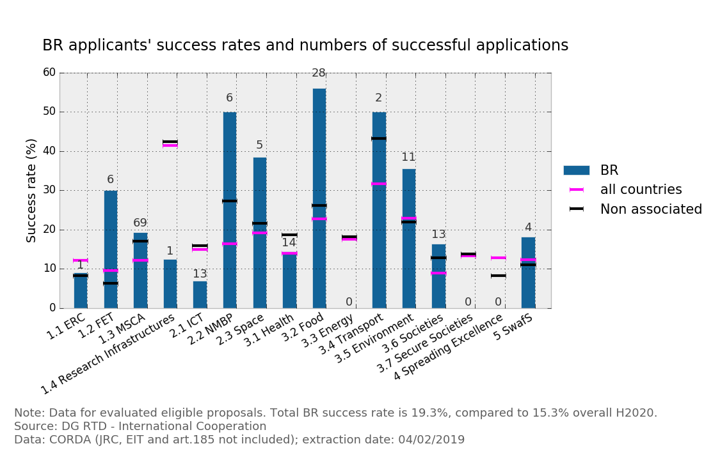
BRAZIL SUCCESS RATE (19,3%)
International average 15.3% after more than 2400 projects
Note: Data for evaluated eligible proposals. Total BR success rate is 19.3%, compared to 15.3% overall H2020. Source: DG RTD – International Cooperation Data: CORDA (JRC, EIT and art 185 not included); extraction date: 04/02/2019

Slide 12
CONTACT
Goret Pereira Paulo Goret.Paulo@fgv.br Fundação Getulio Vargas Brazil
https://cooperacaoeu.fgv.br/

