Slide 1
IR Campus Aix / Franco Norwegian Academic Cooperation
Webinar 8th March 2022

Slide 2
Aix Marseille University in numbers…..
Created at the start of the 15th century, AMU was formed in 2012 and is the world’s largest French speaking University.
80 000 students enrolled in 17 faculties on 5 campuses, 58 individual sites in 9 PACA region towns.
122 research structures, 12 doctoral schools, 18 specialist institutes, 10 000 international students .
10 000 international students enrolled either as free movers or on an exchange; 1200 international PhD students; around 7000 exchange programmes in Europe and abroad.
Innovation and Knowledge Institute (CISAM)
European Civic University with 9 partners (CIVIS)

Slide 3
IR Campus Aix – Arts, Languages & Humanities Faculty Law Faculty
Aix en Provence centre, 10 000 Law students et 15 000 Arts and Languages students on a newly renovated Campus with 3 restaurants, 2 libraries, a sports centre, theatre and 5 Halls
ARTS, LANGUAGES & HUMANITIES
350 Erasmus & CIVIS exchange agreements
32 international bilateral exchange agreements
40 pluri and multidisciplinary agreements
20 IPD
LAW
49 Erasmus et Civis exchanges
15 international bilateral exchange agreements
29 pluri and multidisciplinary agreements
17 NOHA partners
2 IPD

Slide 4
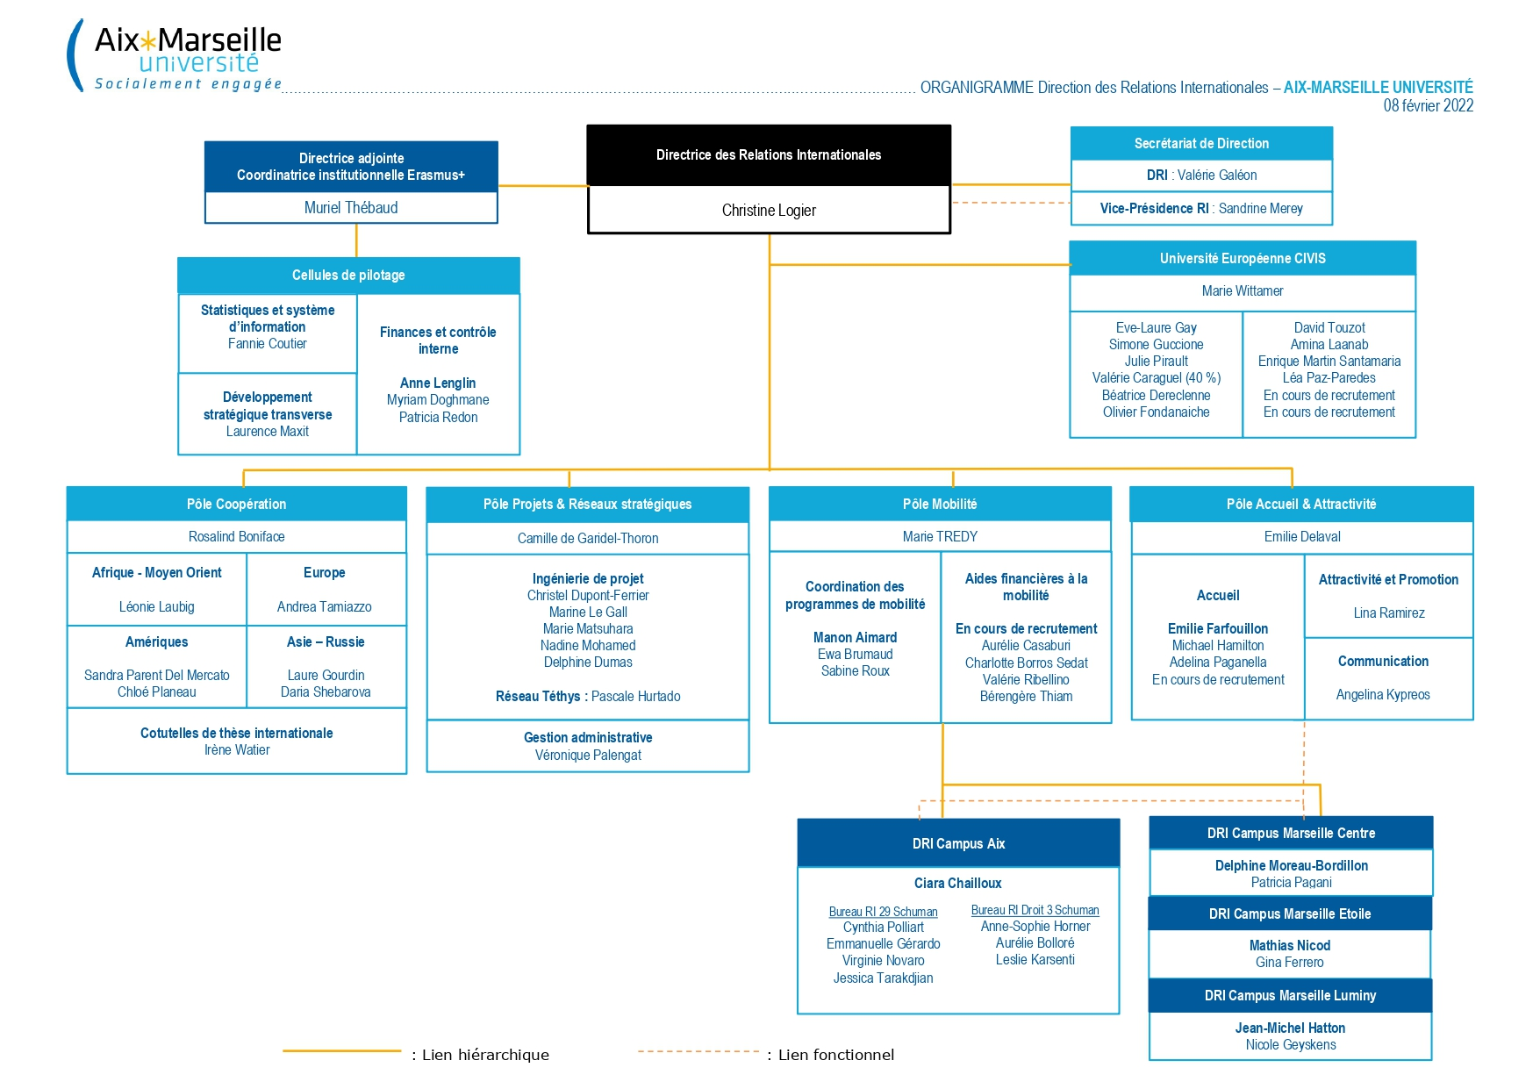
IR at Aix Marseille University

Slide 5
Who Benefits from Cooperation ?
Students
Teachers
Staff

Slide 6
How Can You Build a European Cooperative System ?
Teacher
Partner
IR Office

Slide 7
How it Works
Teacher writes up a cooperation project with prospective partners.
The project will be approved and signed by the teacher’s fellow department members
The agreement will be signed by the Dean of the Faculty
A virtual version will be added to the EWP dashboard and to the Faculty destination catalogue
We look forward to meeting our new students (and our students are delighted to be going to a new destination!!)
IR Office will liaise with partner for terms and conditions such as field, level, numbers, language requirements…

Slide 8
Promoting Mobility
Erasmus Days, Student Fairs, University Open Days
« Dare to Exchange » (Osez La Mobilité) live and online events
On site IR Office with dedicated personnel
Liaising with teachers in target departments

Slide 9
Norway and AMU AMU
Law Faculty
Historic exchange since 1987 with Oslo University (5 students / semestre)
Exchange agreement with Bergen
Tailor made programme (Lectures, Tutorials)
Open only to Norwegian Master students on single semester exchanges
Excellent contact with Jens Peder Lomsdalen (Oslo) et Nathalie Gaulier (Bergen)
Plus Points
Numbers flexibility – both partners will accept extra students, late nominations
Incoming Norwegian students tend to favour courses in Maritime and International Law – in 2010, two Oslo students decided to continue with a Masters in Maritime Law as Free Movers.
French students love the lifestyle and smaller university

Slide 10
Norvège et AMU
Arts, Languages and Humanities
Exchange Agreement between Oslo and the French department
5 x places per semester in / out
Less popular that the exchange with the Law Faculty but students of French tend to not be attracted to exchange programmes though the choice is vast.
Plus Points
Possibility of taking courses in any Faculty department subject to availability and IR tutor’s approval
35 Degree courses and 23 Master Courses
Catalogue of English taught courses

Slide 11

The Future
Meetings and events such as today!
Fairs, Conférences, STT………..
We need to use the last two years experience to widen our offer of « alternative mobilite3s (virtual; summer schools etc)
Extend agreements to language students, Psychology, and History sectors.

Slide 12
Thanks for your time!
Ciara.chailloux@univ-amu.fr

