Slide 1

How to register & book your meetings guide

Slide 2
Registration
Input your personal details
Input your organisation details
Your profile – as it appears on the platform
Request Meetings
Search the participant list
Send meeting requests
View meeting details
Invite a colleague to join a meeting
FAQs / Contact details

Slide 3
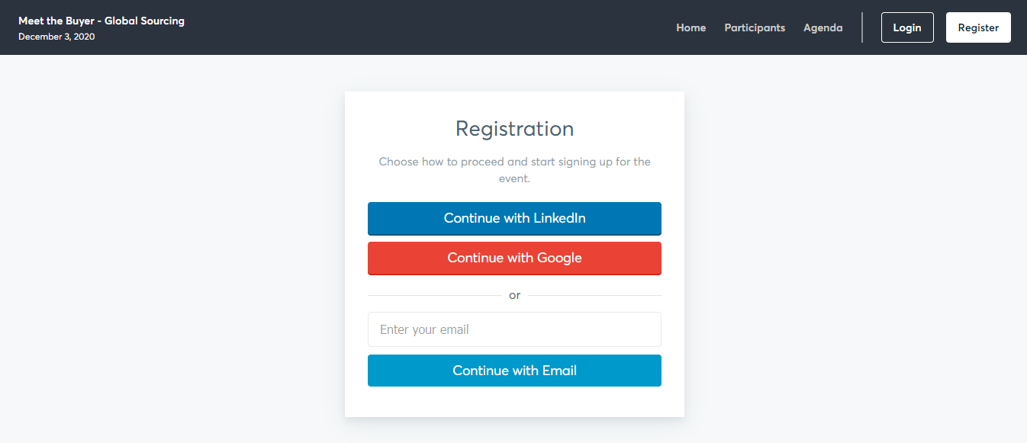
Registration
Register with your own email address and create a password. You must have access to this email as you will receive an automatic email to verify it.
Return to Contents Page

Slide 4
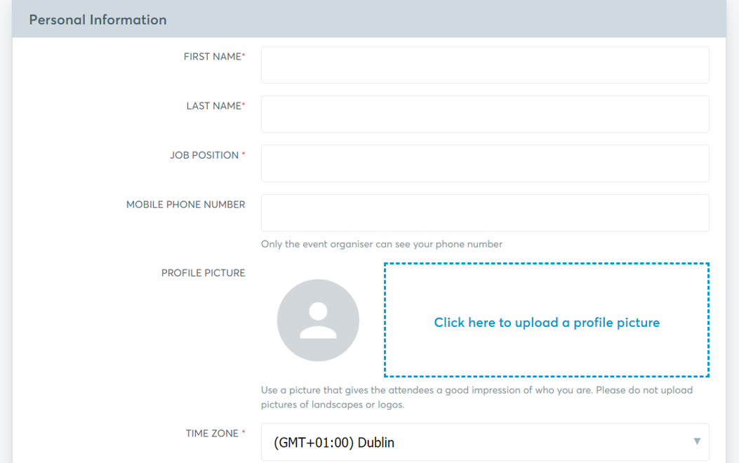
Personal Info
Input your personal profile information. Your name, job title and photo will be visible to other participants on the event platform. Select the service areas relevant to your business.
Return to Contents Page

Slide 5
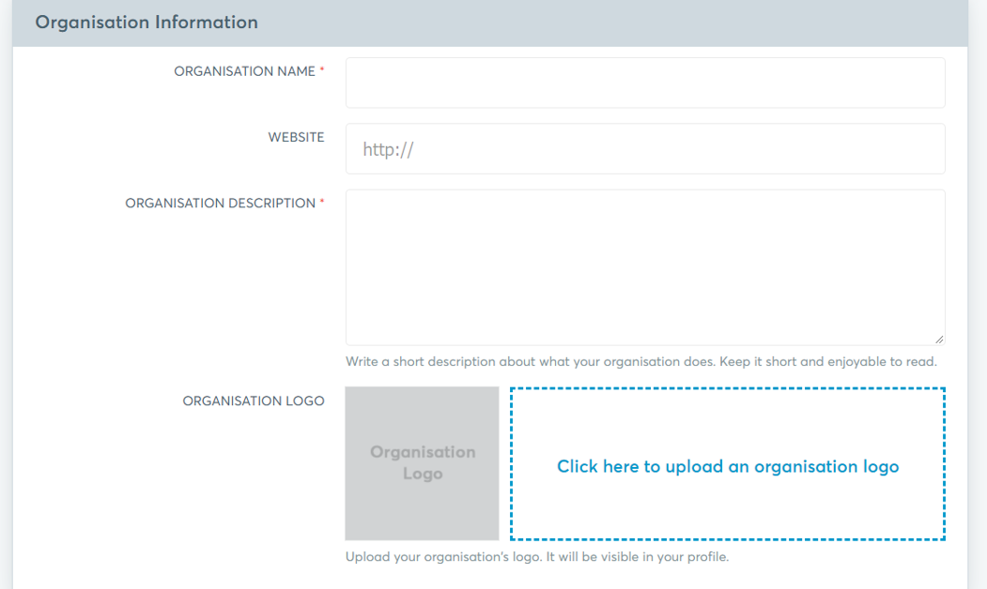
Organisation Info
Your organisation details will be visible to other participants on the event platform. Please input a clear and concise profile so they buyers can determine that they are the best person to assist you.
Return to Contents Page

Slide 6
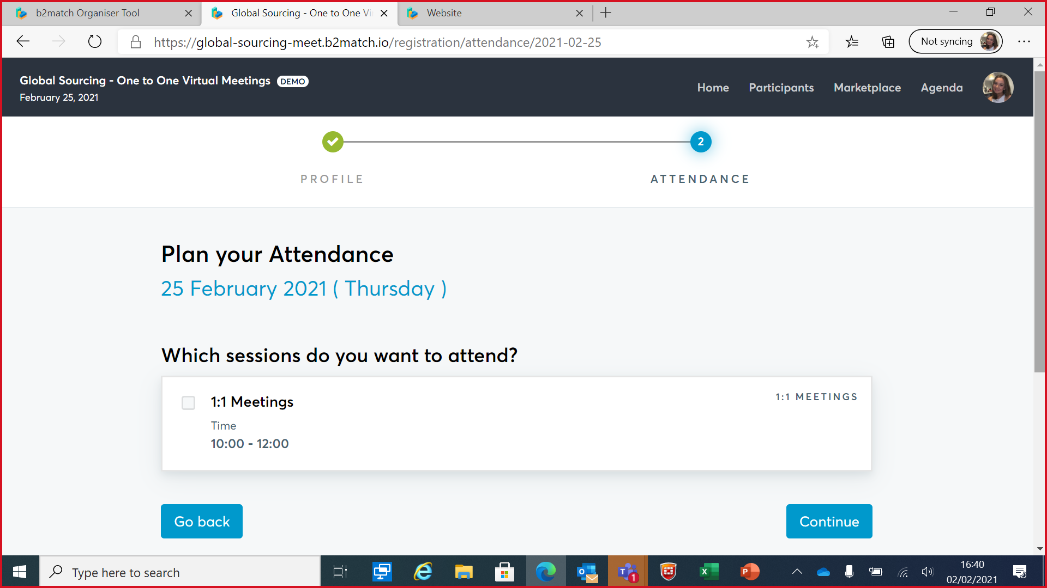
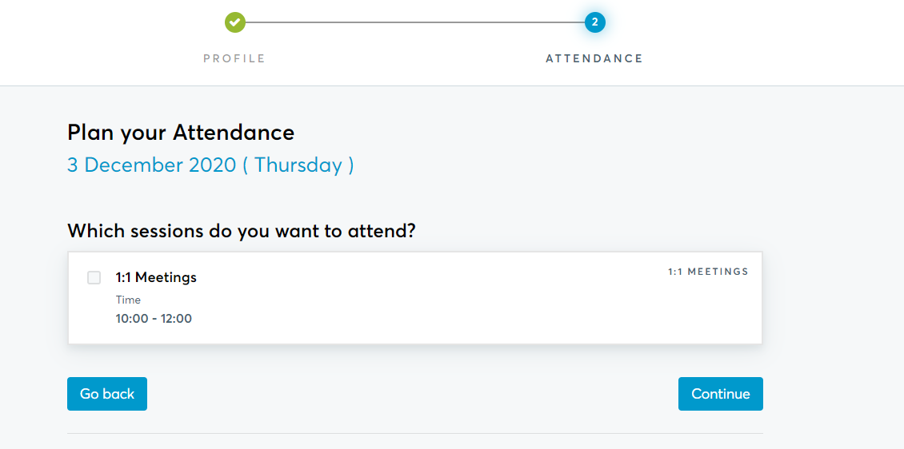
Agenda
This is where you indicate the times you are available. To request meetings, you must select your availability for as many meeting slots as possible (ideally ALL). This will increase your chances of securing meetings.
Return to Contents Page

Slide 7
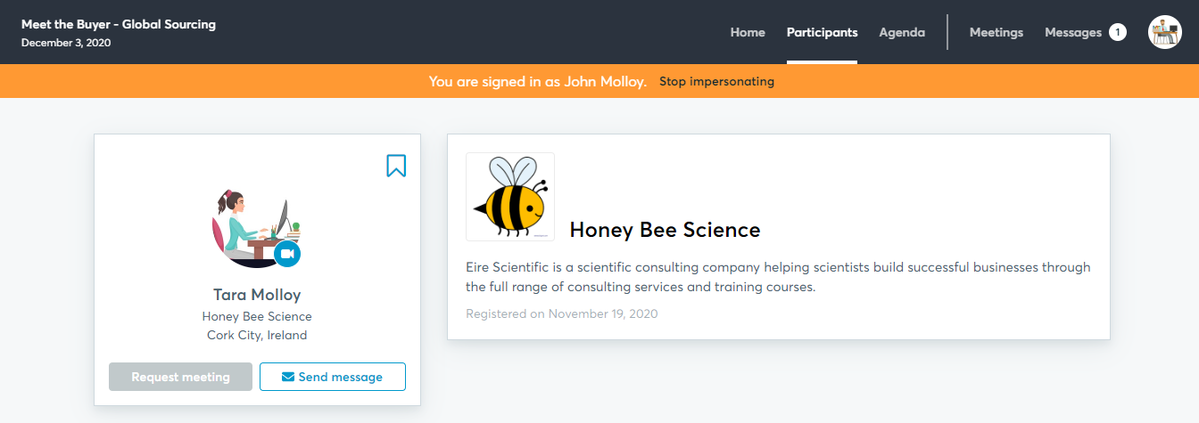
Your Profile
This is how your profile will look to other participants.
Return to Contents Page

Slide 8
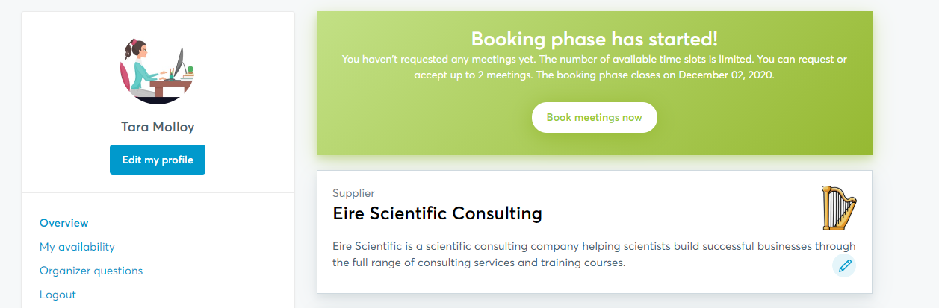
Request Meetings
Click on Book meetings now and start to search the participant list of the preferred tenderers.
Return to Contents Page

Slide 9
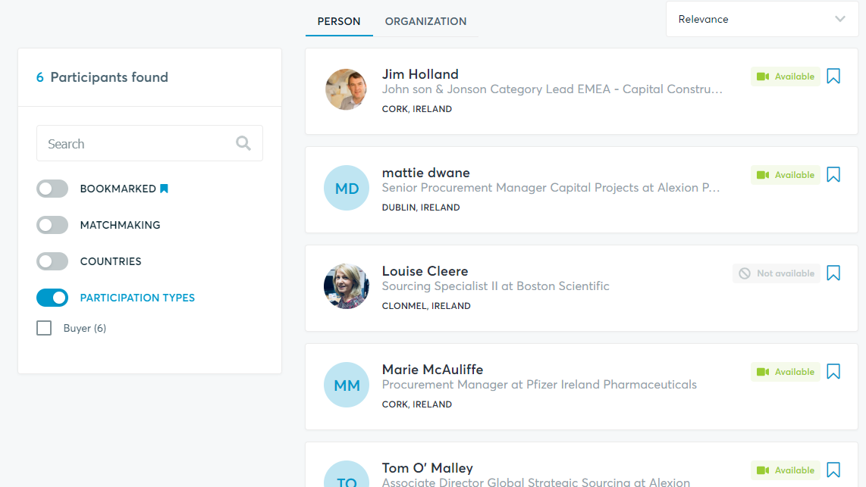
Participant List
Click on Participants in the top navigation bar to start your search.
You can also use the keyword search.
Click on the participants name to view their full profile
Return to Contents Page

Slide 10
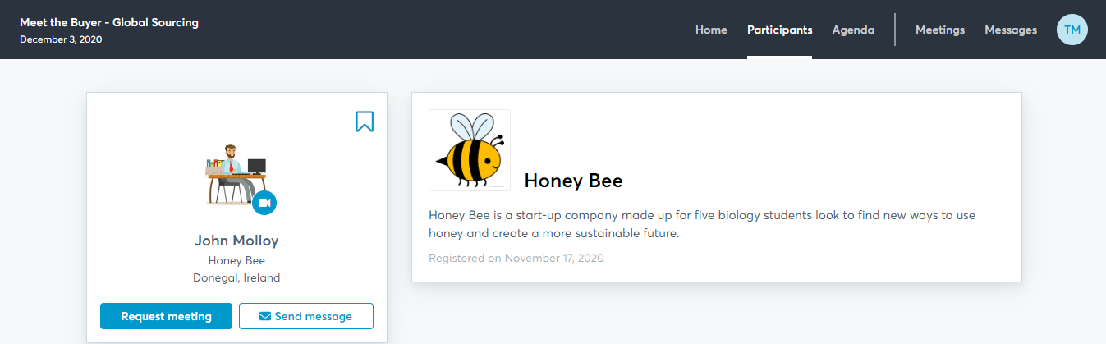
Send Request
View the profile, request a meeting or send a message. You can request a maximum of 3 meetings. You do not request the time, the buyers will schedule the meeting based on their availability. You can view and message other companies, but you can only request meetings with buyers.
Return to Contents Page

Slide 11
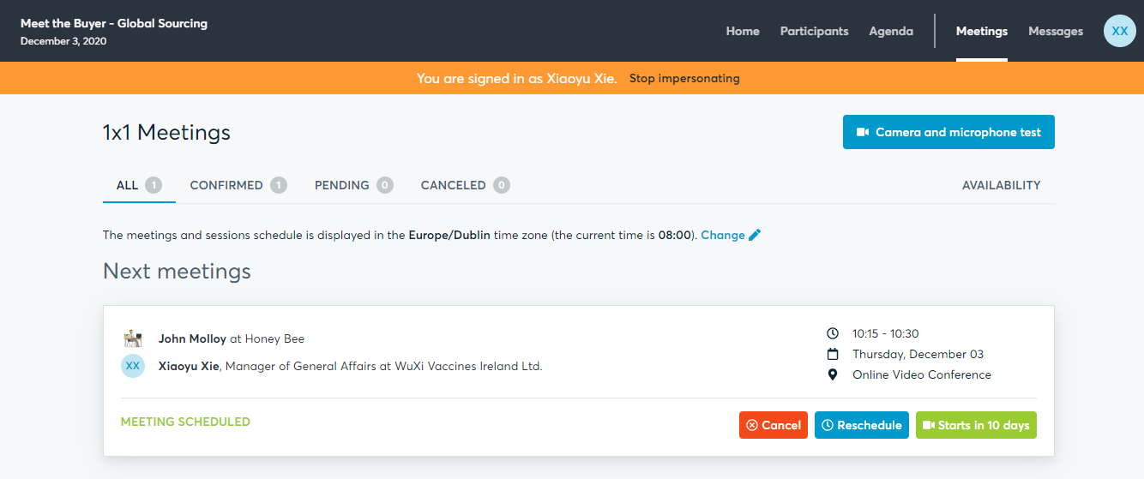
Your Meetings
Meetings will automatically be accepted. However, a contractor/buyer may use their discretion and cancel this meeting at a later point if it is deemed unsuitable. You can view your all meeting details under Meetings.
You will join your video meeting by clicking on the green camera button.
**NB** Remember to do a tech check using the camera and microphone test button in advance.
Return to Contents Page

Slide 12

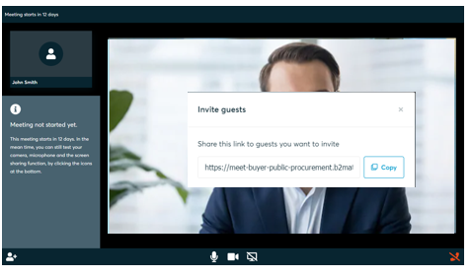
Invite a colleague to join a meeting
In your Meetings tab, click on the green camera button. This will open the video call window. Click on the add people icon - - in the bottom left hand corner. Copy the unique link for this meeting and send, with the meeting details and day/time, to your colleague. They can join the meeting by pasting this link directly into their web browser.
Return to Contents Page

Slide 13
You can request meetings until COB Tuesday 24th May
Any questions…
Email sarita.murphy@enterprise-Ireland.com
Return to Contents Page

