Slide 1


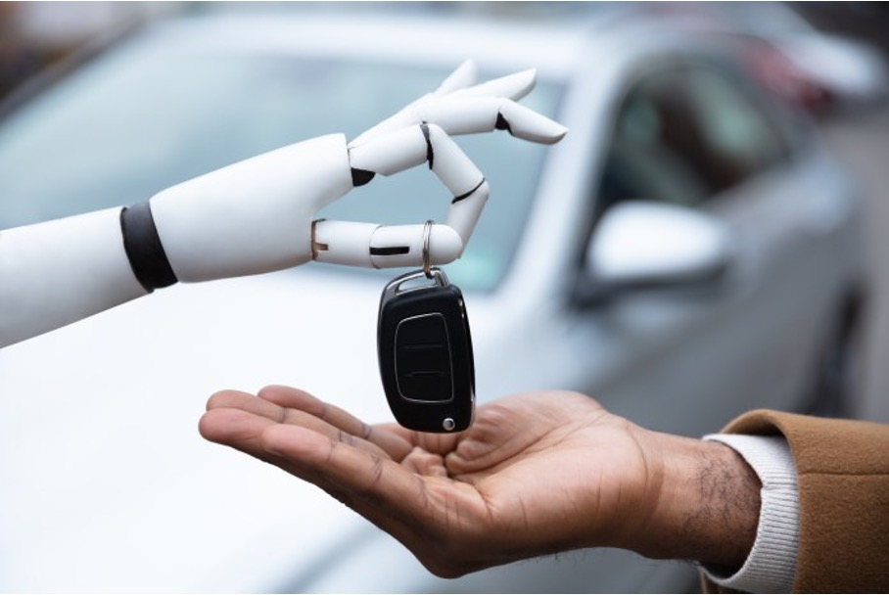

“Artificial intelligence in Horizon Europe calls: an interdisciplinary challenge”
How to know
when to press STOP
& by whom
SSH for a human & sustainable impact
Bram Lievens – SMIT, Vrije Universiteit Brussel
https://smit.research.vub.be

Slide 2
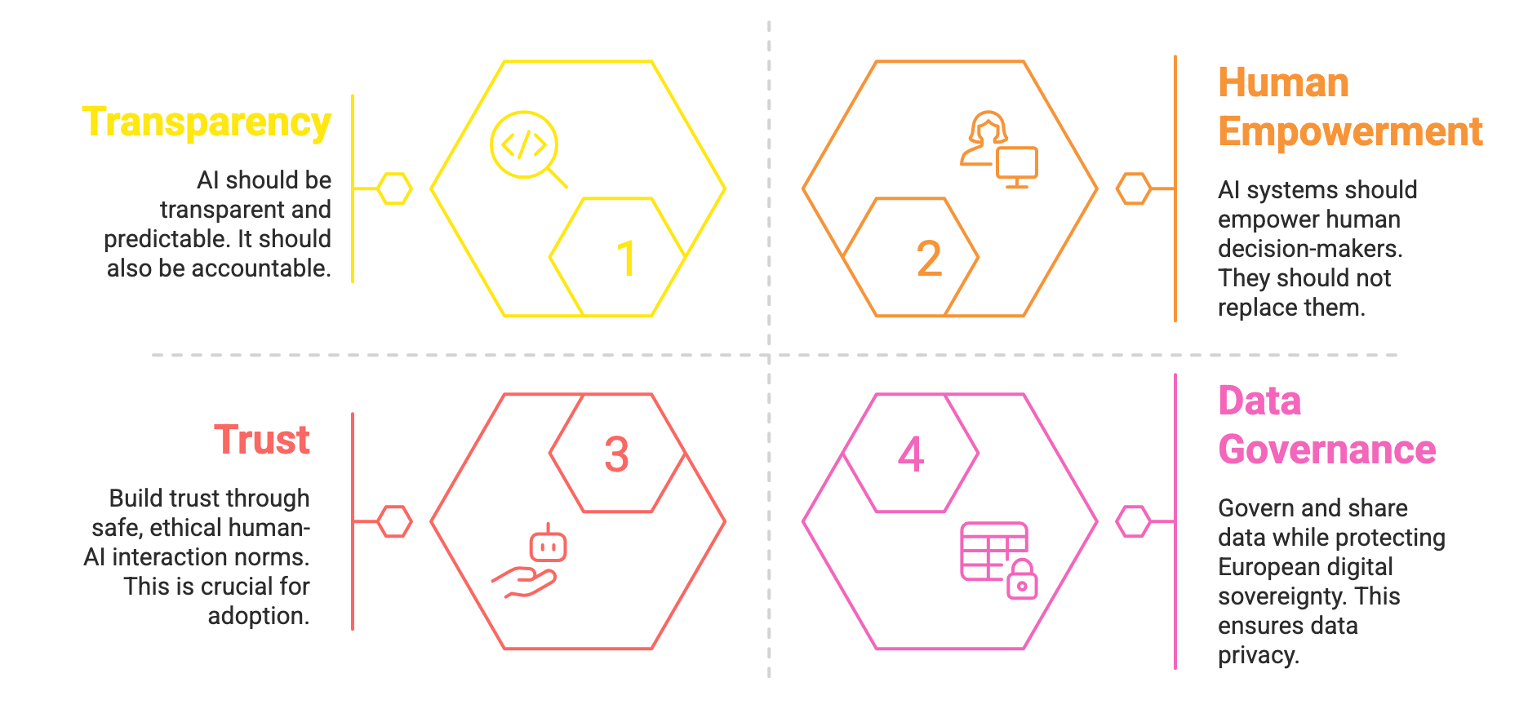
Our expertise
Addressing non-technical challenges in AI solutions

Slide 3



Topics of interest
MEANINGFUL
HUMAN
OVERSIGHT
DATA
GOVERNANCE
TRUST
EMPOWERMENT

Slide 4
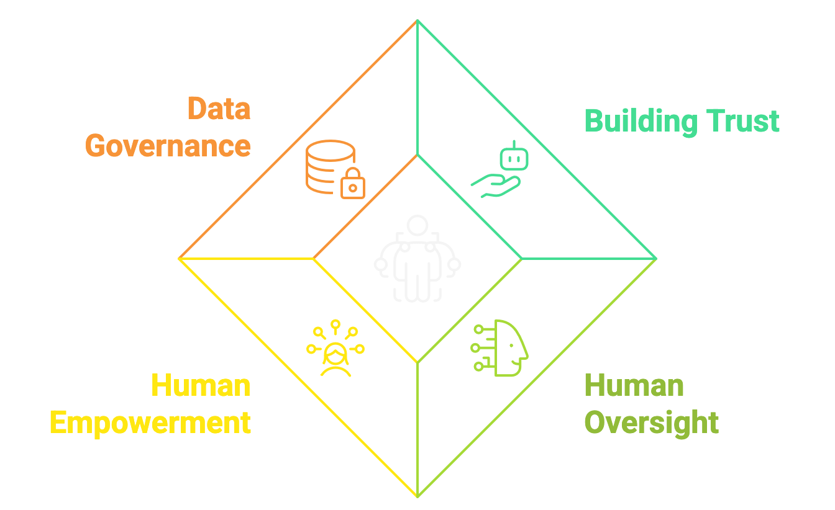
SMIT SSH collaboration
How to govern and share data responsibly and sovereignly?
Establish governance models protecting rights and sovereignty.
Enable compliant, transparent data access for AI innovation.
How to build and maintain trust in autonomous AI?
Identify which socio‑technical factors drive user trust.
Define design requirements that ensure transparency and reliability.
How to design AI that genuinely empowers humans?
Ensure humans remain primary decision‑makers in AI‑supported tasks.
Strengthen user competence, confidence, and control through design.
How to ensure meaningful human oversight?
Implement effective oversight and intervention mechanisms.
Integrate human‑in‑the‑loop controls into existing workflows.

Slide 5
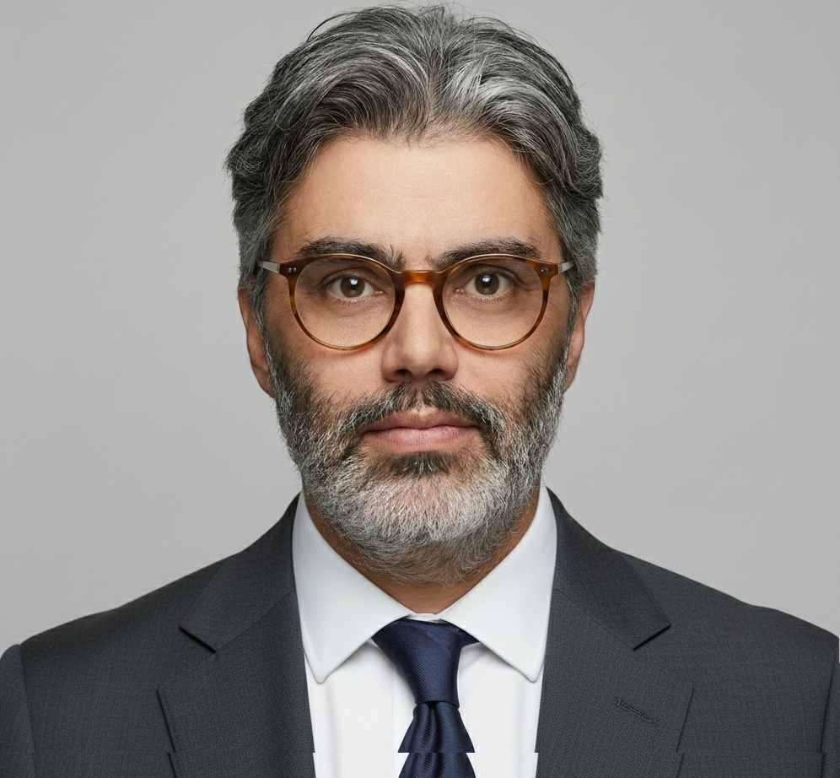
Contact us!
Leading SSH research center in technology RDI
Strong expertise & track record in SSH in digital innovation
Interdisciplinary team of +140 FTE researchers
Embedded in VUB and IMEC
smit.research.vub.be
Bram Lievens
Research valorisation manager
bram.lievens@vub.be
+32 478 72 01 54

