Slide 1


Slide 2
1
Why IPRs matter?
Notes:
So now we are clear about it, why do IP Rights matter?

Slide 3
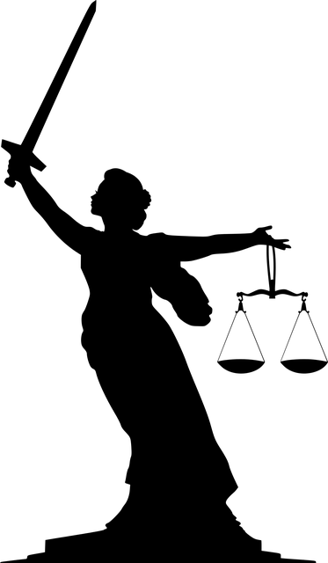

Two aspects to consider
Notes:
Legal & commercial

Slide 4
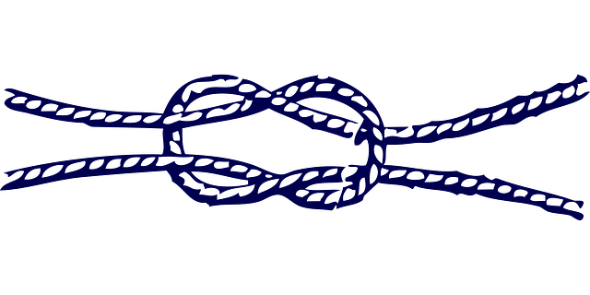
Notes:
These two aspects are closely tied together and thus have to be considered together.
The commercial aspect is linked to those aspects that will bring your offering to your consumer – and how they will be able to easily find your offering online and offline.
The legal aspect on the other hand is linked to enabling you to protect your business future interes – that is to say:
Ensuring those commercial aspects belong to your business – ownership
Defense against counterfeit or copy cats.
Traditionally, the only thing brand owners or future brand owners were worried about was counterfeit and how to deal with it.
The point is that this perception resulted in a low profile approach, which is very dangerous, because you don’t consider IP at all until your business grows and then it’s too late. So don’t be scary of IP, trust IP proffesionals and train and invest in your intangible assets’ protection.

Slide 5
2
Why is IP so important for the
fashion industry?
Notes:
This applies to all business in general… but, how does it affect the fashion industry specifically?

Slide 6
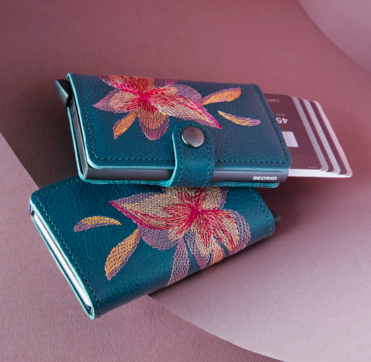
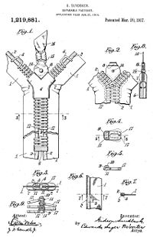
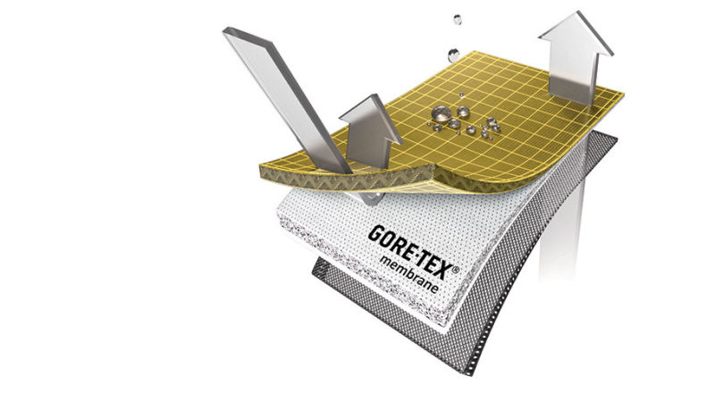
Why is IP so important for the fashion industry?
Notes:
Remember that we mentioned that IP Rights are everywhere? Yes. That would be the fist argument. But you also have to bear in mind that although IP Rights tend to be associated with technological industries, fashion is also an IP intensive sector.
And, the third argument, wouold be that IP Rights are almost the only way:
to have an exclusive right over your creations;
and obtaining revenues and a competitive advantage.
For example:
Trademarks are useful not only to indicate the business origin of your goods, but also as a reference of their quality or exclusiveness (As you know, consumers tend to be brand-driven and Trademarks are the best way to guide their buying decision).
Design are suitable to protect the external appearance of handbags, jewellery or sunglasses, among others.
And you can bet that the technology of Non-iron Shirts, waterproof jackets (like those with the Goretex seal) and the cushioning system of your running shoes are protected by Patents.

Slide 7
Why is IP so important for the fashion industry?
Highly competitive environment
Differentiating your products from your competitors’ → success/failure
Your reputation and goodwill are vital
Products’ short life cycle
IPR are an effective internationalisation tool
It is necessary to:
→ Create an identity
Secure its ownership
Carefully consider the business model in the internationalization process
Be prepared for counterfeit
Notes:
But should that be not enough, I’ll give you 5 more reasons:
The fashion sector is a highly competitive environment;
where differentiating your products from your competitors’ ones may make the difference between success and failure
In this context, your prestige and goodwill are vital and IP can help you building your reputation and strengthening your market position
Given the breakneck speed of this industry, you’d better squeeze your creations
And, IPR-based business models have been shown to be an effective internationalization tool.
And what are the consequences of this? That you must:
Create an identity, meaning a comprehensive and consistent branding
Secure its ownership, by means of protecting every relevant IP Right
Carefully consider the business model in the internationalization process, as not all would suit you.
And Be prepared for counterfeit, which is impossible without securing ownership.
---
in Latin America.
This was the case of the Spanish company HAWKERS, which expanded across Colombia, Mexico, Brazil, Chile and Peru and thanks a franchising business model based on a strong Trademark and Designs strategy
Los DPI son como una huella digital.
Algo único.
Pero que además crean valor en todas las direcciones;
Valor para clientes, socios y propietarios de la marca

Slide 8
Why is IP so important for the fashion industry?
New project
Trade Marks
Designs
Patent
Copyright
Industrial secrets
Domain names
Trade dress
Traditional knowledge
Utility Models
Notes:
And what I mean with “protecting every relevant IP Right” is that you must know:
How many are there
What are they for
And Which one you really need
---
Cada uno de estos elementos puede podrá encontrar-se con la vertiente comercialización y litigio.
Ya sea en fases iniciales de registros o más avanzadas como puede ser infraciones o falsificaciones.

Slide 9
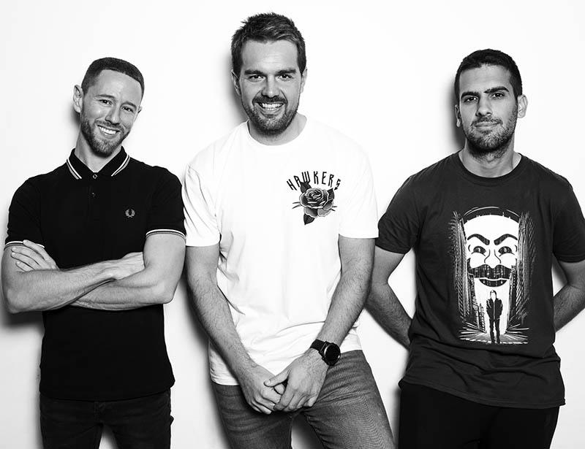
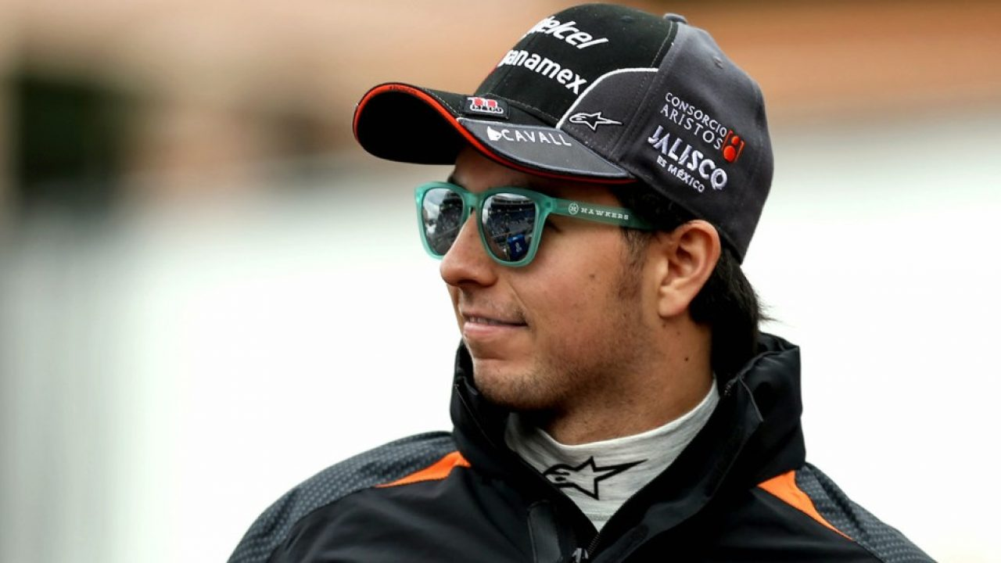

Why is IP so important for the fashion industry?
Notes:
For example:
the Spanish company HAWKERS, expanded across Colombia, Mexico, Brazil, Chile and Peru thanks to a digital-based business model (now they have many own stores, but when they began it was purely online) based on a strong Trademark and Designs strategy. As simple as that.
It is true that they took care of their branding, with fresh ad campaigns, good SEO (using Facebook Ads) and sponsoring the right celebrities (like el Chico Perez or Messi), which also implies Domain Names, Copyrights and some Trade Secrets.
---
Cuidado con las redes sociales: https://expansion.mx/mercadotecnia/2018/01/30/asi-cuadriplico-sus-ventas-hawkers-despues-de-su-tropiezo-en-twitter
Presencia física en América Latina (de online a offline): https://mx.fashionnetwork.com/news/Hawkers-abrira-sus-primeras-tiendas-fisicas-en-mexico-este-ano,943517.html

Slide 10
3
How to safely exploit your
creations in Latin America
Notes:
Do you want to follow their steps?
Then pay atention to how can you safely exploit your creations in Latin America & India

Slide 11
A
Secure ownership
Notes:
And how do you do that?
First: securing ownership, which refers both to identification and protection of IP Rights.

Slide 12
TRADEMARKS IN LATIN AMERICA
Register before you go → the bad faith registration scenario
What to register
Traditional vs non-traditional trade marks
Registration requirements
Duration of registration proceedings and protection
Well-known trade marks
Notes:
Registering your Trade mark must be the first step, even before you start distributing your products in Latin America. Just for you to know, Trade marks are the most commonly infringed IPR in the fashion sector.
Once registered:
it will be easier to build your reputation in the region
it will provide you with more legal certainty when signing distribution or license agreements.
AND… it will prevent you from bad faith registration. A very classic example is when a local distributor files a European Company’s Trade mark in his own country (known as agent’s mark). Or when companies with no links to you apply for your reputed EU Trade mark in Latin America to benefit from its reputation or to sell it to you (the “legitimate owner”) at a higher price.
So, please, go register before you go.
Speaking of registering, what can you register? Well, you could protect the sign (which could be a word, colour, phrase, logo or even the shape, the smell or the melody, where the non-traditional trade marks are accepted), for commercialising certain type of products or services. The link between this two elements (sign and type of products and services) is what matters when it comes to availability and enforcement. And I can tell you more about it later if you’re interested.
MX: 3d, smell and sound
AG: Three-dimensional, tactile, smell, sound and moving
BR: 3-D
CL: three-dimensional, olfactory, pattern, multimedia, holographic, movement, position or tactile marks or any non-regulated type
Now, what are the registration requirements?: It must be distinctive, it must be available and it must be graphically representable or perceptible (depending on whether this non-traditional trade marks are accepted).
How much does this protection last? 10 years counted from the filing date (Mexico) or the granting date (Argentina and Brazil). And, listen, this is very important, because, generally speaking, registration proceedings vary a lot from country to country (In Mexico it is just a few months, in India 1-2 years, but in Brazil or Argentina, it could take 3 years or more). The good news is that it could be renewed forever. You heard that? FOREVER. This is why it is sooooo important to your company. Because, under normal conditions, the value of the company goes up year after year, but the fees remain the same. And if yours becomes a well-known trade mark, you could even benefit from extra protection (like legal protection without registering the trade mark locally or extend the protection to products and services you don’t deal with). But you gotta be protected at least in one country for that.
Our name is covered. Now let’s move to the appearance.
---
Well-known Trade marks enjoy a higher degree of protection thanks to their reputation in a given country. All countries in Latin America belong to the Paris Convention, which grants protection to well-known Trade marks under article 6 bis. However, you have to bear in mind that the scope of protection and the proceedings for obtaining such protection vary from country to country. Usually, the “extra” protection consists of the possibility of opposing non-registered well-known Trade marks against Trade mark applications in a given country. Other countries, additionally, entitle the holder to extend the Trade mark´s scope of protection beyond the scope of the specialty principle (See glossary). The requirements for its protection may involve applying for registration of the non-registered Trade mark, which is the case of, for example, Brazil or Chile. In Argentina, it is not clear whether or not a Trade mark that has not been used in the country could benefit from well-known Trade mark protection, while in the Andean Community (composed of Colombia, Peru, Bolivia and Ecuador), well-known Trade marks that have been used in any of the member countries benefit from additional protection, if not, the Trade mark holder bears the burden of proving that it is well-known in the relevant sector. (

Slide 13
INDUSTRIAL DESIGNS IN LATIN AMERICA
What does it protect specifically
Modelo vs dibujo
Registration requirements
Grace period
Duration of protection
Non-registered designs
Notes:
Because, how do you protect the external appearance of a product, including its shape, configuration, colour, materials or texture? With Industrial Designs.
In Latin America, you have 2-Dimensional designs (known as dibujo), which are for textile prints, for instance; and 3-D designs (known as modelo), which are for belts or eyewear. Easy, right? Well, what if I told you that countries such as Chile and Venezuela explicitly exclude clothing from Design protection? Yeah, I know…
Actually it is not that bad, as in Chile you are entitled to register your textile prints. But it is shocking anyway.
As to the registration requirements, your design must be new, which implies that no identical or closely similar Design has been applied for, commercialized or otherwise disclosed in any part of the world. Yep, worldwide novelty matters, my friends.
In addition, some countries, like Argentina or Venezuela, also require singularity or originality of the Design to grant the protection, whereas other countries, such as Honduras or Mexico, also require industrial applicability.
But coming back to the novelty, I have some good news for you, because, upon certain limited conditions, you can register the Design after its disclosure or commercialization without harming its novelty, provided that the lapse between the disclosure date and the application date is no longer than 6 or 12 months, depending on the country.
Such a possibility is indeed very useful in this sector, as it offers the option of testing the products in the market before deciding to register them; and kind of compensates the lack of protection for non-registered designs (with the exception of Guatemala, Nicaragua and Panama). With such a short life cycle, I know it sounds unfair, but… It is how it is and now you know it.
Finally, as to the duration, unlike trade marks and love, it does not last forever, and it varies from 5 to 25 years.
---
The maximum duration of the registered Design is not harmonised in Latin America. It is 10 years in Colombia, Peru, Chile or Ecuador and 15 years in Honduras, Panama, Argentina or Uruguay. In Brazil and Mexico, however, protection can be obtained up to 25 years from the application date (a first period of 10 years with three subsequent renewals of 5 years each one).

Slide 14
Industrial Designs
 | Mexico | Argentina | Brazil | Colombia | Chile
Proceedings | 10-18 months | 1 week | 8-12 months | 6 months | 1.5 –2 years
Duration protection | 25 years | 15 years | 25 years | 10 years | 15 years
Grace period | 12 months | 6 months* | 6 months | 6 months | 6 months
Notes:
And if you were wondering how much does it take to register, the protection duration or the specific months covered by the grace period, there you go.
These amounts were updated last week, and refer only to the anual oficial fees, which means that you must add:
The IP lawyer fees
The prior searches costs or
Document translation
If you wanna have a more detailed estimation to tour case, just contact us.

Slide 15
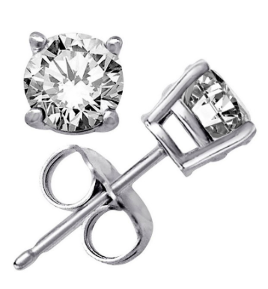
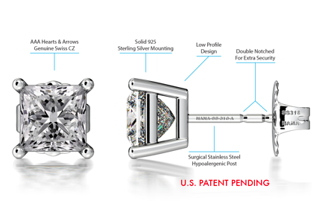
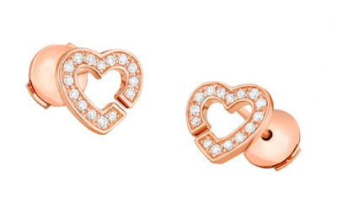
PATENTS IN LATIN AMERICA
Notes:
OK. We got the name and the appearance protected. What’s next? The technology, of course.
We saw that the solutions to technical problems are no odd in this industry. These earrings are some good examples. It may sound simple, but the double notched system was awarded with patent protection, as well as the magnetic closer.
The requirements that they met for that were 3:
Novelty, inventive step and industrial applicability.
Novelty is clear, right?: Nothing identical in any part of the world anytime before filing the application. Except your own commercialisation, as we also have a grace period of 12 months here.
The industrial applicability is also very obvious, but what it may not be –and must not be- so is the inventive step. Because, technically speaking, if, for an expert with average skills in the technical field concerned, the invention is neither obvious nor obviously derived from the state of the art, then you can check the inventive step requirement.
And once granted, what is the duration for patent protection? 20 years counted from the filing date. And you have no extension. So, make them count.
Speaking of international registration, only Argentina is not member to the PCT.
And registration proceedings duration is significantly longer:
Brazil: Up to 10 years or more
Argentina: 3-9 years
Mexico: 3-4 years
India_ 4-6 years
However, you can get your Patent granted in a faster way thanks to the Patent Prosecution Highway (PPH). The Patent Offices of Argentina, Brazil, Chile, Colombia, Ecuador, Paraguay, Peru and Uruguay launched the Patent Prosecution Highway (PPH) Pilot Program in order to accelerate the examination procedure by using the examination results issued by one of the Patent Offices (Earlier Examination Authority) when examining an application with the other countries´ Patent Office (Later Examination Authorities). Similarly, there is a PPH for the Alianza del Pacífico between Chile, Mexico, Colombia and Peru.
In Brazil there is also the Green Patent Programme, which aims to contribute to environmental care and aims to accelerate the examination of patent applications related to clean technologies. What is the average granting time? 6 to 12 months (compared to 7 to 10 years through the ordinary process). The substantive examination phase takes in average 6 to 18 months, similarly to what happens in the ordinary process.
Second use:
Colombia: NO
Many other: YES

Slide 16

Copyright
What does it protect
Protection requirements
Registration vs Berne Convention
Duration of protection
Notes:
And now it’s copyright time.
I bet you all know something about it, but let me remind you that Copyright refers to the rights of creators over their literary, artistic or scientific works. In other words, catalogs, pictures, videos, books, illustrations, music or ad campaigns… and SOFTWARE.
The requirements for protection are just two: originality and fixed intangible means of expression (for instance, a sketch, a voice recording… you got the picture).
And, yes, I said protection, not registration, as this artistic works do not need to be registered in order to be protected, but it is very useful in terms of proof of authorship and mandatory in case of certain legal actions. And this is possible thanks to the Berne Convention, an International agreement all Latin American countries are members to, that provide reciprocal recognition of automatic protection in any other member country.
For how much? It depends… It goes from 50 years from the publication to 70 years from the autor’s death.
Uruguay: 50 years
Chile: 70 years
Argentina: 70 years
Who is the owner?
By default, all rights are reserved, unless indicated otherwise (copyleft: Creative Commons). It must pay attention to the source and use of the protected work (Not every disclaimer realy reflects the protection status of the work, some may be subject to copyright protection althought it states “copyright-free”).
And here also comes open source.
Just bear that in mind.
---
The applied arts are all the arts that apply design and decoration to everyday and essentially practical objects in order to make them aesthetically pleasing.^{[1]} The term is used in distinction to the fine arts, which are those that produce objects with no practical use, whose only purpose is to be beautiful or stimulate the intellect in some way. In practice, the two often overlap. Applied arts largely overlaps with decorative arts, and the modern making of applied art is usually called design.
Source: wikipedia

Slide 17
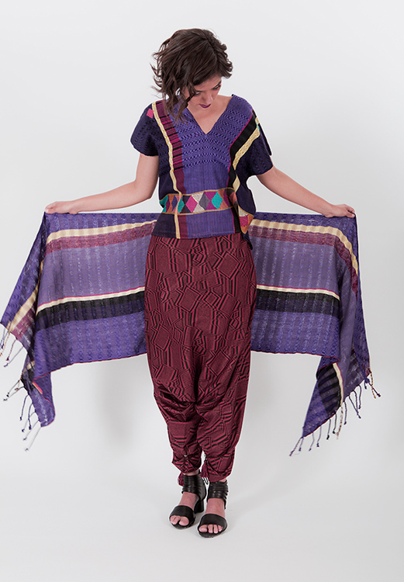
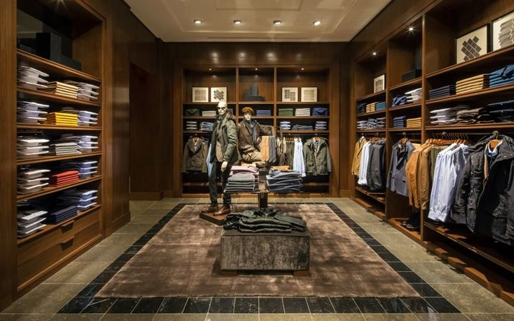
Trade Dress, Traditional Knowledge + Trade Secret and Domain Names particularities
in Latin America
Notes:
Beside the said IP Rights, which are the most relevant ones, there are some other realities that must be considered.
From the point of view of the purchase, in this sector, how you display your products is, sometimes, as relevant as the products themselves. In fact, the combination of colours, smells, commercial stands, packaging or furniture in shops can lead to a singular commercial display that consumers link to a given commercial origin. And when this is original, it deserves some protection. I’m talking about Trade Dress, which, as the other ones that you can see there, is not an IP Right, but a mean to protect a product or service image or experience.
Depending on the country, your Trade Dress protection strategy may differ. For example, in countries that provide for three-dimensional Trademarks registration, such as Cuba or Colombia, it is feasible to register your shops’ Trade Dress as a Trademark, as far as it is distinctive.
Other countries, such as Uruguay, protect Trade Dress without the need for registration and entitles you to license it by means of franchising contracts. Brazilian protection, on the other hand, is based on Unfair competition, whereas in Mexico it is advisable to combine Trademarks, Designs and Unfair Competition.
We also have Traditional knowledge, which applies to traditional handcrafted textile products. This became very popular due to the “cultural appropriation phenomenon”. And very sensitive too. And as it may affect your reputation, I strongly advise you to contact an IP expert prior to commercialising fashion products inspired by or containing such textiles in order to avoid any infringement, because these very inspirational products can be protected by cultural heritage or Appellations of Origin.
And finally, we have Trade secrets, which is very useful to protect client’s lists or the know-how of product’s manufacturing (meaning the technique). The good thing about this, is that no registration is needed and it could last forever (as long as it is kept secret), but some requirements must be met in order to obtain legal protection over it.
And what to say about Domain Names. Anyone could register them, but if you have some registered trade mark, you may claim it in case of unfair registration, under certain conditions.
If you want to know more about it, do not hesitate to ask during the Q&A.
Now you have an idea about how you can deal with IP in Latin America, but my colleague Hana Onderkova, will let you know the specifities of India.
---
Más información aquí: https://masdemx.com/2017/10/iniciativas-moda-diseno-textil-tradicional/
1) The information should always be secret, which means that it should not be generally known or readily accessible to people outside the SMEs.
2) The information must have commercial value –or at least potential commercial value- because of its secrecy. Brazil, however, does not require commercial value to protect the information by means of Trade Secret.
3) And, The information must have been “reasonably protected”. For example, out of non-company personnel’s sight, signing a Non-Disclosure Agreements with any person to whom all or part of the secret information is given (including employees, potential business partners, etc.) or any other organizational and technical measures to restrict access to the information.

Slide 18
Registration strategy : international systems
The PCT :
Inventions
The MADRID SYSTEM.
Logos, slogans, company name
Smell
The HAGUE AGREEMENT :
Shapes, forms, textures
GOOD FOR :
Operate in multiple countries in s/m term
Medium-High budget level
Start negotiation with several local potential partners
Franchising, licensing-based business models
Participation in Trade Fairs
Marketing type portfolio
Notes:
PCT
Argentina, Uruguay, Paraguay, Bolivia, Venezuela are NOT members to the PCT
Madrid System
India, Colombia, Cuba, Mexico, Brazil and Chile are the only members
Hague Agreement
only Mexico joined.

Slide 19
Costs
MADRID SYSTEM :
A basic fee (653 CHF / 903 CHF for color*) plus
Additional costs depending on where you want to protect your mark and how many classes of goods / services will be covered by your international registration.
Transmission fee from Office of origin, translations, etc.
  Note: After obtaining an international trademark registration, additional fees apply to expand the geographical scope of coverage, modify or renew your trademark portfolio.
PCT :
International filing: 1330 CHF
Search: 150-2000 CHF
Transmittal: c.a. 100€
National entry fee: e.g. 160€ (MX)
+ translations, etc.
HAGUE AGREEMENT:
a basic fee (397 CHF for one design; 19 CHF for each additional design included in the same application),
a publication fee (17 CHF for each reproduction; 150 CHF for each page on which one or more reproductions are shown) and
a standard designation fee or an individual designation fee for each Contracting Party where protection is sought.
  Note: For standard designation fees, a three-level structure applies, reflecting the level of examination carried out by the contracting party.

Slide 20
B
Choose the right
Business model

Slide 21
Exploitation strategies
Control over how the product/service reaches the end consumer
Investment required
Profitability
Risks assumed
Specifities of the business model
Notes:
Now, the second pilar of your internationalisation strategy is choosing the right business model, for which you must have a very clear idea of:
How much control you wanna have over the final user’s experience
How much money would you need to implement it
How much money are you going to earn
What are the risks
And the specifities of the business model at hand regarding the type of product, geographical area, objective target, etc.

Slide 22
Exploitation models
Assignment
Licensing
Distribution agreement
Franchise
Subsidiaries
Other ways:
  Using it as a negotiation tool
  Increasing your company valuation in the framework of merger and acquisition transactions
  Attracting investors
  Offering it as a collateral to obtain financing
  Tax-deducting purposes
Notes:
That said, and as a recommendation, prior to starting to exploit your IPRs in Latin America, you’d better take into account these key points and their coherence with your company’s strategy, because there are significant differences between business models: for instance, assigning your IP Rights entails a lower risk and requires little investment. However, you will have lower profitability potential; while creating subsidiaries will ensure control over the exploitation of your IPRs, but requires a high investment and will have little sense if you are not interested in establishing your company in the country in the short or medium term. And, as you can see, there are many business models (there you have the most popular ones).
But beside them (which are more focused on the cash), there are many other ways to benefit from your IP portfolio. Like:
Using it as a negotiation tool (cross licensing)
Increasing their company valuation in the framework of merger and acquisition transactions
Attracting investors
Offering it as a collateral to obtain financing (David Bowie knew best)
Or Tax-deducting purposes
---
Beside them, you can also opt to sign a Distribution agreement or créate a Franchise or Subsidiaries.
Distribution agreement with a local partner: Its main advantage is that it allows you to put a foot in the country with a relatively low investment level. However, the margins are not as high as in other alternatives and it is difficult to control how the product reaches the final consumer, which implies a reputational risk.
Franchise: Franchising is halfway between licensing IPRs (mainly Trademarks) and creating subsidiaries; it provides more control on how the product reaches the final consumer than licensing, but it is a considerably less expensive strategy than creating subsidiaries in the foreign country.
Subsidiaries: In certain cases, having your own company / manufacture / selling points in Latin America may be the most coherent option with your business strategy, since it allows you to have higher control over all the production and distribution channels. However, it requires strong investment and implies higher risks.
SMEs may also find other ways to benefit from their IP portfolio, for instance:
Using it as a negotiation tool
Increasing their company valuation in the framework of merger and acquisition transactions
Attracting investors
Offering it as a collateral to obtain financing
Tax-deducting purposes

Slide 23
4
9 tips to protect your brand abroad
Notes:
Do you want to follow their steps?
Then pay atention to how can you safely exploit your creations in Latin America & India

Slide 24
1.
Seek professional assistance.
Notes:
One-man band complex (Bert, Mary Poppins): You shouldn't do it all yourself.
balance between taking on certain tasks internally and outsourcing
Why? Because there are certain things that:
Others do better (design your IP protection strategy based on your interests and resources)
You can't do → you'll need a local representative to register your IP rights.

Slide 25
2.
Design your brand identity carefully and protect all its elements.
Notes:
Difference between Brand (signature or style) vs Trade Mark (registered sign)
Elements that make up the brand and that must be protected:
Product or company name, slogan, logo or colors → trade mark
Mascot, product photographs, jingles, all audiovisual material for campaigns and social networks (photographs, videos, GIFs) → Copyright
Digital presence → website and apps → Industrial Designs and Copyright
Domain Name (name of the company or of a collection). → domain name scams, ever heard about them?

Slide 26
3.
Make sure that you own these elements before registering them.
Notes:
You have to make sure that you have ownership of these IP Rights, because they may have been made by an employee, an agency or taken from the Internet.
Name, design or drawing → you have to check who they belong to (by default)
Include clauses and / or ensure that it can be used like this (content banks have licenses with terms of use) before registering them (they may prevent commercial use, with modification, with assignment of authorship).

Slide 27
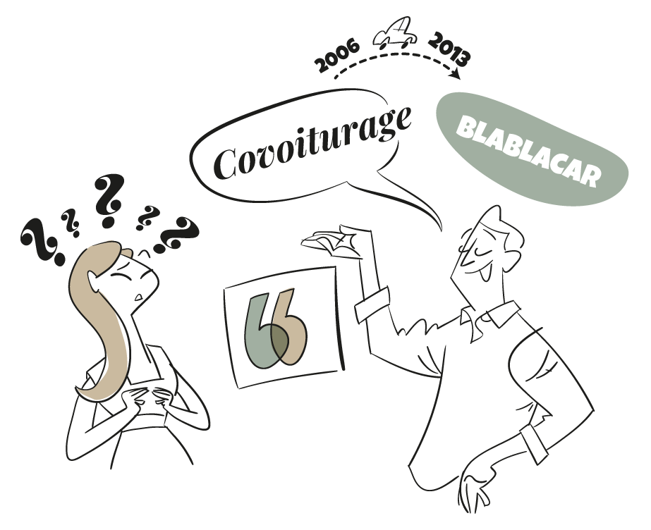
4.
Think
globally,
not
locally.
Notes:
Use names or signs that can be reproducible and distinctive in all the countries in which you plan to operate in the medium term.
Beware of names that are difficult, impossible to pronounce or that have another meaning in the local language (even contrary to morality).
Example of bad IP strategy: Covoiturage (2006-2013)
During the first 7 years of the company's life, they operated with an unregistered trade mark (lack of distinctiveness: covoiturage is a fully descriptive term in French) and an app design → industrial design (already in the public domain).
In non-Francophone countries the term was not easy to pronounce.
After a lot of work, they managed to find an available, distinctive sign that would work well for the public. If they had made that effort from the beginning they would have saved a lot of money.

Slide 28
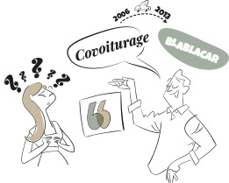
4.
Think
globally,
not
locally.
Notes:
Good IP strategy example (alternative): Unilever with Frigo → buys famous local brands and changes their logo, maintaining positive associations about these brands. Here the weight has been put on the logo (the graphic part: the spiral-shaped heart)
In Mexico: Holanda

Slide 29
5.
Search for
prior
trade marks thoroughly.
Notes:
Company name and star product name
Not only of identical signs, but also confusingly similar (in terms of name or sign), and in terms of the type of products and services (complementary or substitutes: beers and wines → class 32 and 33). We will explain this later (point 8).
Where to look:
databases (online, reliable, comprehensive, in your language, free)
market
If it is not available → you have to choose another or reach a coexistence agreement (coexistence agreements are more complicated in Latin America, because they have to be examined and approved to protect the consumer's interest)
The same applies to designs.

Slide 30
6.
Benefit from international protection mechanisms (where available).
Notes:
Berne Convention (Copyright), Madrid System, etc.
Benefits: right of priority, reciprocity, registration through a single application in multiple countries; protection similar to the EU Trademark (Decision 486).
Not all countries are members:
Make agreement: Only Mexico is a member
Madrid System: Only Mexico and Colombia, and, very recently, Brazil (+ Chile). Cuba is also a member

Slide 31
7.
Take into account registration time differences.
Notes:
10 years (from submitting the application or since it is granted)
Some countries take longer than others → between 6 months and 5 years
It affects renewal and entry into the country (especially if there are partners who require it)

Slide 32
8.
Define the types and products you aim to commercialise.
Notes:
Nice classification: what is it (example Polo)
Polo is registered by Volkswagen for cars and Ralph Lauren for clothing
This classification coexists with local classifications (eg Brazil)
Be careful with registering types of products that you DO NOT intend to use → cancellation (obligation of use 3/5 years).
Lack of use detected by other new applicants who in their conscientious searches see that there is nothing on the market (although they may be wrong)

Slide 33
9.
Protect
before
you go.
Notes:
Territorial Rights
What is registered in Europe does not protect abroad
Low profile does not work
Trade mark may be lost after negotiations (agency registration)

Slide 34

INTERNATIONAL
IP SME HELPDESKS
WE ARE
AT YOUR DISPOSAL
BUSINESS-ORIENTED
WORKING FOR EU SMES
FREE OF CHARGE
CONFIDENTIAL
www.ipr-hub.eu
Notes:
Go to our website to find further materials and information and do not hesitate to ask.

